Slide 1
Twitter Trends
Candel and Sy

Slide 2
Executive Summary
Twitter was founded in early 2006 and it is a free social media site where people communicate with each other and post short messages called tweets. Nowadays people use twitter to get the latest updates like News reports, to follow famous people and to share their thoughts to the public. With internet connection and smart devices, people can access the website or the app.
We analyze twitter data to discover which topics are trending on Twitter.

Slide 3
Introduction
Twitter is a social media platform that allows people to post texts, images and videos. It is widely used to write blogs with a limited number of words shorter than any other social media. Users can freely post whatever they want. Unlike Facebook, they have community standards to follow which makes it different to Twitter. Due to this difference, Twitter users over use the platform that can be harmful and alarming to other people. User’s frequently post therefore the latest internet sensation is posted earlier in twitter.

Slide 4
Objectives and Metrics
This paper aims to explore trending social media hot topics in the Philippines across open-access social media platforms: Twitter.
Tweets - Information about user posted
Volume - Information about the number of users using the trend.
Count - Information about the the number of tweets

Slide 5
Objectives and Metrics
Social media could help content creator to know the rising trends to promote their works:
To know the current trends.
Ranked trends according to the number of tweets.

Slide 6
Scope and Problem Statement
Trends - which topics included in top 50 trending topics
Volume - which trending Tweets has highest counts

Slide 7
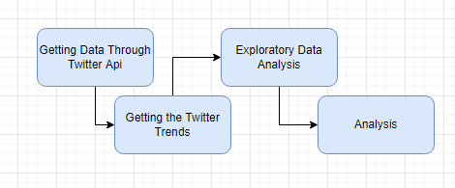
Methodology

Slide 8
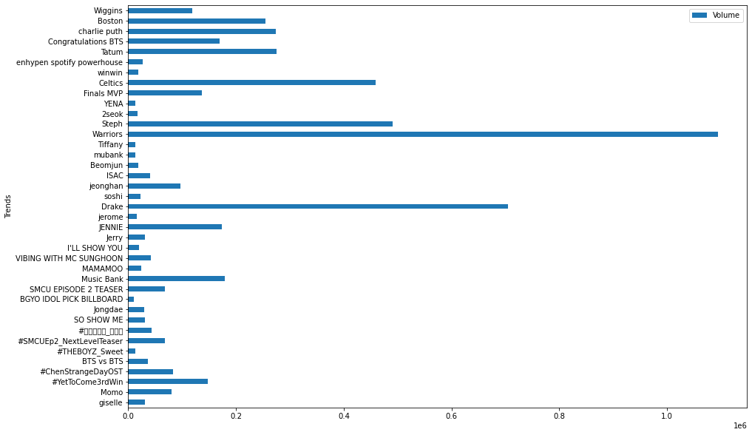
Top Trends in Philippines

Slide 9
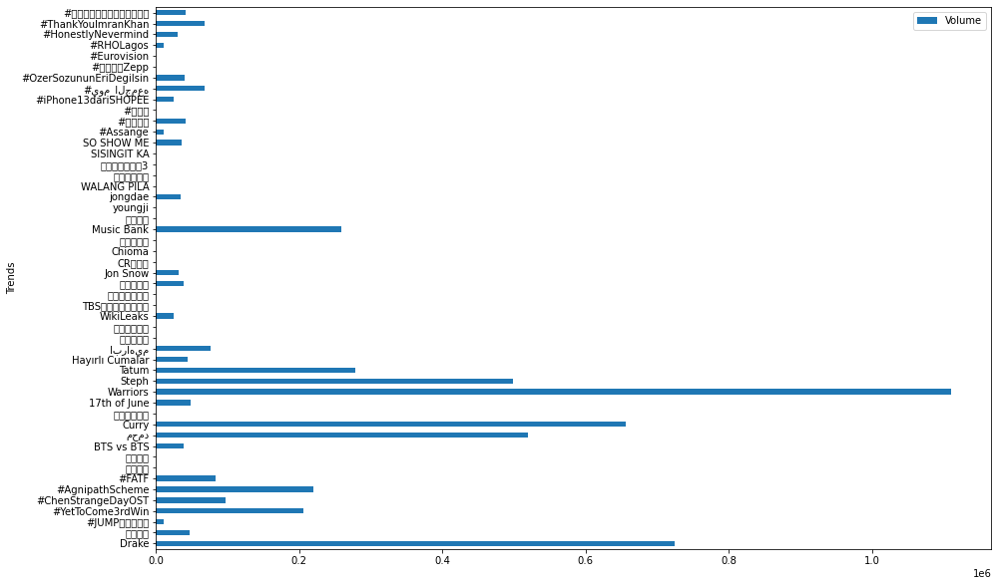
Top Trends around the World

Slide 10
Insight,Conclusion and
Recommendations
This project shows the top twitter trends around the world and in the philippines. This could help the user or the content creator to know which topic are trending to fit to their content. Therefore we conclude that the top trending topic shows that Warriors has the highest volume of tweets for today.

Slide 11
Thank You !

